Slide 1


P.S.V COLLEGE OF ENGINEERING AND TECHNOLOGY (Approved by AICTE ,New Delhi & Affiliated to Anna University, Chennai) (AN ISO 9001:2008 certified Institution)
DEPARTMENT OF ECE
NATURAL DISASTER INENSITY ANALYSIS CLASSIFICATION BY USING ARTIFICAL INTELLIGENCE
ABINAYA.K (611819106002)
NISHA.B (611819106033)
PRIYADHARSHINI.M (611819106040)

Slide 2
SYNOPSIS
ABSTRACT
INTRODUCTION
OBJECTIVE
RESEARCH METHOLOGY
REVIEW OF LITERATURE
DATA ANALYSIS
ROLE OF AI
CHALLENGES FOR AI
LIMITATIONS OF AI
CONCULSION

Slide 3
Natural hazards have the potential to cause catastrophic damage and significant socioeconomic loss. The actual damage and loss observed in the recent decades has shown an increasing trend. As a result, disaster managers need to take a growing responsibility. A number of research studies apply artificial intelligence (AI) techniques to process disaster-related data for supporting informed disaster management. This study provides an overview of current applications of AI in disaster management during its four phases: mitigation, preparedness, response, and recovery. It presents example applications of different AI techniques and their benefits for supporting disaster management at different phases, as well as some practical AI-based decision support tools.
KEYWORDS:Disaster resilience· Disaster management· Artiﬁcial intelligence
ABSTRACT

Slide 4
INTRODUCTION
Disaster is any event which leads to damage to the environment and society we live in, thus create huge
Impact on human life. Disaster can cause damage to the environment and society . Artifical intelligence is the important to prevent from damage . It is the tool can reduce the life risk on environment . Crisis leads to complexity of situation and requires management in saving life, preserving Infrastructure and resources . Artificial Intelligence (AI) has gained immense popularity in today’s time and the use of AI as a tool can Reduce life risk, damage to environment, impact to society and respond to disaster situation in a stronger way.

Slide 5
OBJECTIVE:
• To study the impact of disasters on humans and society.
• To identify post disaster situations faced by people.
• To study the human behaviour in relation to artificial intelligence.
• To identify the use of artificial intelligence in disaster.
•To find out ways of prevention of disaster

Slide 6
RESEARCH METHOLOGY:
: The primary source of this research is through a questionnaire for the study of artificial Intelligence and the how it can be useful for managing disaster while being responsive in managing and Reducing the impact.
The secondary data was collected from online websites and articles related to Technologies and their use in disaster risk reduction.
PRIMARY SOURCE
SECONDARY SOURCE :

Slide 7
REVIEW OF LITERATURE:
The paper highlights the use of artificial intelligence, how it can be Used to prevent the natural hazards.
FOR EXAMPLE : If the natural disaster arises before . It can be identified by AI so it is very useful for our society
Decision making and measures that can be done based on the Data gathered to improve resilience can be identified.(Muhammad Arslan, Ana-Maria Roxin, Christophe Cruz, January 2018) It provides a literature review of Various papers

Slide 8
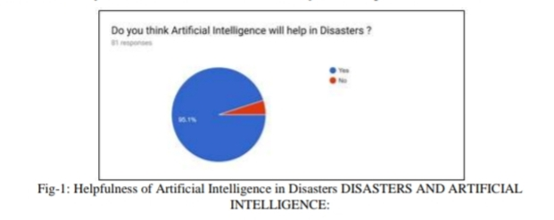
There are various natural and Man-made disasters which creates an impact every year.
The natural disasters are at a large scale and have a great potential of loss. These Disasters are floods, earthquakes, wildfires, and storms etc.
The humans caused disasters include industrial accidents, terror attacks and incidents that create violence. There is need for evacuations and protection required for such disasters.
DATA ANALYSIS:
NATURAL DISASTER
Based on the survey results the outcomes have been analysed and represented below:
MAN-MADE DISASTER

Slide 9
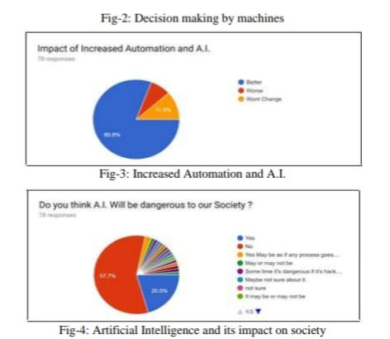
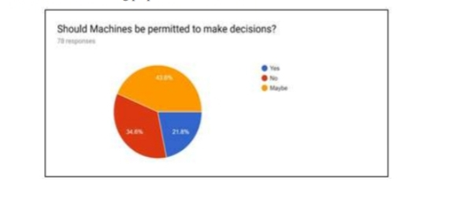
The role of artificial intelligence in such disasters is required and important for analysing the situations and
To come out with solutions for being prepared to face Disasters.
ROLE OF ARTIFICAL INTELLIGENCE:

Slide 10
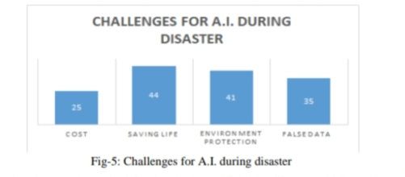
CHALLENING OF ARTIFICAL INTELLIGENCE:
There are various challenges for Artificial Intelligence as a machine could not possess all the human Qualities.
1 . AI is used to save our life .when compared
With all the bars
2 . AI is saves our life

Slide 11
where people face disaster And get their reviews which would help to develop artificial intelligence technology for managing the Situations before any event occur.
AI is the main method to identify a disaster before it occurs By using more techniques , equipments Etc…The disaster’s can prevented
LIMITATIONS OF STUDY:

Slide 12
CONCLUSION:
Cost: There is a huge cost required for developing artificial intelligence which requires a few skills, Advanced technologies.
Saving Life: AI is built with algorithm and too much of technicality is involved.
Human source: saves the environment and peoples safety by the AI

Slide 13
THANKING YOU...

